Slide 1
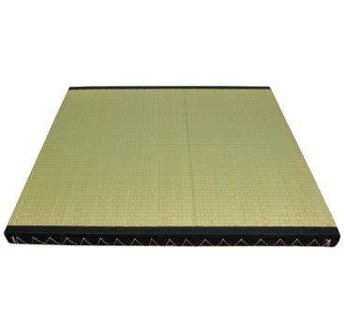
TaTAMi
Taint
Tracking for
Application
Migration
MSc Research Presentation, Lee Beckman
Notes:
Hello All, I’m going to presenting an overview of my master’s thesis research, which I have been doing under Rodger and Eric, with a lot of help from Nima.
The name I’ve given it for now is TaTAMi, which stands for…
Taint Tracking for Application Migration, and the meaning of that will all be made clear shortly.

Slide 2
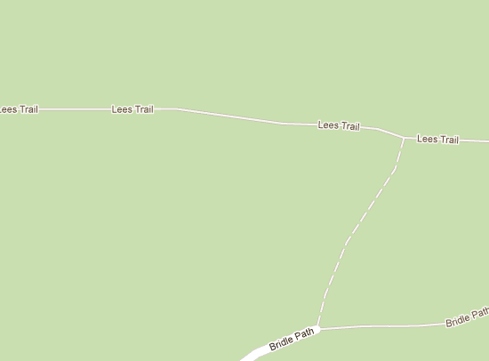
Outline
Thesis
Motivation
Questions
System
Application
Future
Questions
Questions
Questions
Notes:
As a quick outline for how this presentation is going to go, here’s the path I’m going to follow.
I’ll start with a quick statement of my thesis, so we have a base to tie everything that follows together.
Then I’ll move into some motivation, basically a high level description of some problems to solve, as well as some related research which has been influential in shaping my project.
Next I’ll introduce the system itself, both the parts I have completed and the ones I still need to.
Then, assuming a hypothetical complete system, I will explain and further motivate my work with a conceptual example, showing how I intend to apply my system to solving realistic problems.
Then I’ll finish with some brief words on what is left for me to do, and then take some questions. Of course, you are free to ask questions throughout the presentation.

Slide 3
Thesis
Application + Taint Tracking ->
Guidelines for Migrating Application
Taint Tracking: Tag application data, monitor how it flows through application.
-Composition
-Modification
-Persistence
-Typically used in security
Migration: Deploying application in changed environment to meet growing demands.
-Locally
-Cloud
-Hybrid
Notes:
Simply stated, my thesis is based on the idea given a web application, a technique known as taint tracking is useful for automatically obtaining guidelines for migrating the application.
Taint tracking is the process of tagging the data an application uses, and tracking it’s progress as the application executes. In doing so you can see various outputs originally came from, and pick up interesting phenomena such as data from multiple sources being composed together, data being modified somewhere along its course, and data which persists over extended periods.
Taint tracking has been almost exclusively used in security research for such things as ensuring that untrusted data sources aren’t allowed to affect certain parts of a system. For example, you might tag (or ‘taint’) user input, and raise an alarm if the tagged data was eventually propagated into a database containing administrative settings. I aim to show that this tracking is useful for something very different.
By migration, I mean changing the environment that the application is deployed in, generally for the purpose of scaling the application to support increased demand from its users. This could be done locally, by perhaps adding more servers to your own installation, but the more interesting considerations involve the potential of deploying in the cloud and making good use of the resources available there. A particular variation of this which Nima is studying is a hyrid deployment, where an application is split between a local installation serving some components, and the cloud which serves others.
So overall, I hope to gather data using taint tracking which allows developers and other automated systems to make better, easier decisions about how to adapt existing applications to such new environments.

Slide 4



Motivation
Needs of Applications
Ex: LinkedIn, MySpace, and Flickr
-Major architectural revisions to keep up with growing demand.
-Expensive
-Using Understood Patterns
Demands are placed on an application, requiring change.
-Large, poorly understood, need guidance
-Difficult to know what changes are, safe, optimal
-Estimate use of resources
-Automated analysis needed
Research already exists to this end
-Room for improvement…
Notes:
Okay, now why do I care?
-To start, consider some big examples. LinkedIn, MySpace, and Flickr to name only a few have all undergone significant architectural revisions to keep up with the growing demands of a growing user base.
-Of course these are expensive, requiring a lot and the knowledge of experts of the system to evaluate the potential impact of changes.
-However, some papers have argued that many of the required changes can be broken down into some conceptually simple patterns. Nevertheless, it generally requires a good understanding of how the system works to apply those patterns in an effective way.
So in general, what we’re faced with is a need to change, but when our applications are large, it can be difficult to understand how they actually work, and we could use some help. Especially to know what changes we can actually make, and which of these are safe and likely to yield good results in terms of the resources we end up using for the gains we get. Automation is of course the answer, to help the less-expert developer, and of course there is already a lot of research in this area. I say that there is lots of room for novel improvement, increasing the quality, variety, and specificity of the analysis.

Slide 5
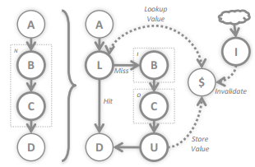
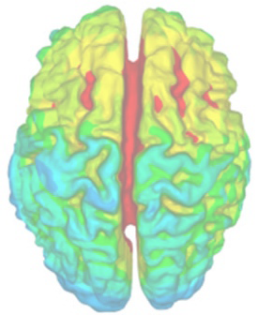
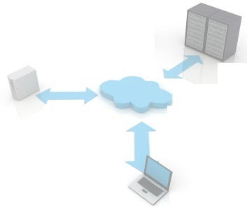

Motivation
Motivating Research
MSR, SoCC ‘10
UC, ASPLOS ‘08
Fluxo: Reusing architectural patterns
-Restricted programming model
-Dataflow representation
-Hueristic transformations
-Caching
-Pre/Post-computation
-Tiering (stateless vs stateful)
Dataflow Tomography: Advanced form of taint tracking, track entire path of data, not just start and end points.
-For understanding large systems
-Easier to understand then CFGs
-Low-level, semantics difficult
-In need of uses
Application Partitioning: Physically splitting an application up.
-Original motivator
-Focus on:
-Graph cutting
-Execution time, communication bandwidth
-Hybrid cloud deployments
-Need to handle state
Notes:
Continuing that thought, here I’m going to talk about a few research areas that have been most influential in shaping my work.
The first is a system called Fluxo, which I believe was done in this lab’s reading group awhile back. Basically, Fluxo is a system to make applying beneficial architectural patterns to large web applications easier. Their analysis is made easier by forcing developers to write applications in a restricted language, which makes the programs easy to automatically convert into an internal dataflow representation. Basically a graph where various computations happen at nodes, and nodes transmit data to each other over edges. They do what they call heuristric transformations on the this graph. Basically they have a few optimizations they’d like to perform, and they scan the graph looking for places to apply them, modifying the graph to reflect the optimizations.
These include caching computed results, pre and post computation of results. Post computation, in a web application, is looking for computation which can be delayed in order to serve a user’s request faster. This could be something like generating thumbnails, which the user may not immediately care about. An important optimization is one they call tiering, where they look for parts of an application which are stateless, basically they don’t keep any data which lives beyond a single request, and separate these out from the rest of the application, so that they can be easily replicated somewhere.
Moving on, another important line of research is termed dataflow tomography, being inspired by detailed medical scanning. Basically this is a heavyweight form of taint tracking. Rather than simply tagging data and seeing where it ends up, you additionally track the entire path of data through an application, seeing how data spreads through variables, and is exchanged between objects. In the paper from 2008, they argue that this technique is useful for understanding large systems, as the data flow graphs generated by it are much more focused then something like a control flow graph. Rather than seeing every single method called to do something, you can focus only on what actually dealt with a particular piece of data you’re interested in.
Their work was very low level, at instructions, and thus benefited by being able to do system-wide tracking across multiple processes and even machines, but at such a low level, saying anything semantically meaningful to a developer is difficult, like telling them class and method names. Additionally, there is little in the way of practical uses for this technique given beyond the vague statement to help with understanding applications.
Next is application partitioning, which was really the original motivator of my research. This involves physically splitting up the operation of the application between sites. Much of the work focuses on taking graph representations of an application, with information about component execution costs and communication costs between components, and cutting those graphs into pieces representing the partitioning.
One area this is useful in are hybrid cloud deployments, where moves parts of, but not all, of their application to the cloud to make use of its resources, but keeps some parts onsite.
This is some of the work that Nima is doing, and the question that started my work was how an application’s state can be considered in partitioning algorithms. For example, if you know that parts of an application are stateless, they can be replicated very easily, and this might influence how you decide to partition.
Finally, I should mention my summer project, which was called DICE (Dynamic Instrumentation for Configuration Extraction). Through this I became familiar with the concepts of taint tracking and dynamic program analysis, and learned of some of the difficulties associated with trying to extract useful data from very low-level tools.

Slide 6
Motivation
-Fluxo limited by restricted programming model
-Dataflow Tomography seeking uses
-Problems such as partitioning need more data
…
Use Tomography to produce Fluxo-like Dataflow representation.
Apply Fluxo-style optimizations
Provide data useful to partitioners, etc
Notes:
Something like fluxo, while offering useful heuristics, but unfortunately requires you to use their programming model,
Dataflow tomography produces dataflow graphs, but is in need of some practical uses,
And problems like partitioning can benefit from additional data about the applications they operate on.
Now, my system is to be situated nicely amongst these issues,
Basically, what if I can use tomography to produce something like a fluxo-style dataflow representation of an application. Then, it may be possible to apply some of their heuristic optimizations to it and then you can optimize without the restricted programming model, and tomography has a purpose. Furthermore, from the tomography graphs it should be possible to find other kinds of data useful to such things as application partitioners, or other automatic tools. The tomographic data is a starting point for all sorts of useful data, and I hope to demonstrate some of this in my research.
Graph as a base point to offer all sorts of useful data. Demonstrate only some of them in my research, could be more to come

Slide 7
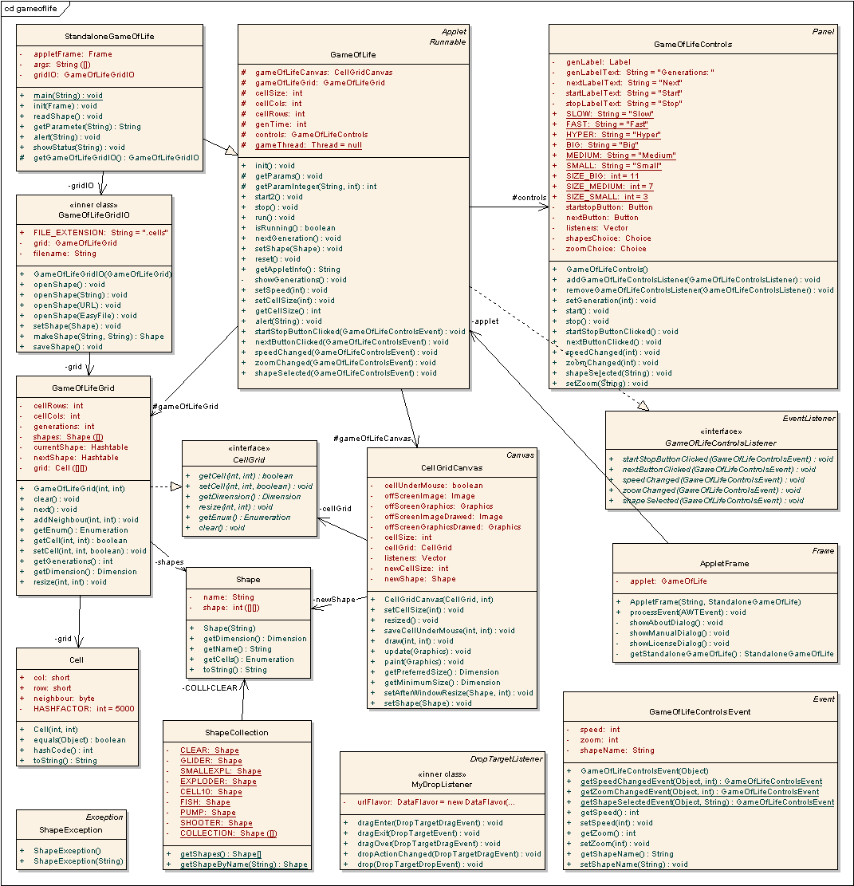

System
Java compiled webapp
+ Libraries
AOP!
Taint Tracking System
-Tag input data (DB read, web request…)
-Intercept:
-All method call/return
-Field set/get
-Modification/composition points
-Track tags across multiple requests
Tracking Logs
Annotated graph
Dataflow graph
Cache
DB I/O
Format
DB I/O
Format
Reloc
Security
Security
Analysis
Servlet
Logger
Servlet
Logger
Notes:
So my system for accomplishing this is as follows:
You start with a compiled java web application and all of the libraries it uses. You wish to migrate this application, so you want to do some automatic analysis.
Then we have my taint tracking code, which is responsible for tagging input data, such as from databases or user requests, and then intercepting any method calls, field reads and writes, and places in the program where tagged data is modified or mixed together. It is also responsible for monitoring what data is used over the course of multiple requests, as this constitutes application state.
Much of this is enabled with aspect oriented programming, which takes my taint tracking code and weaves it into the application and its libraries. This produced a modified version of the application which is run, producing tracking logs generated by my system. And as a side note this is about where I am at implementation-wise. Then, these logs will be used to generate dataflow representations of the application, showing where various pieces of application data travel for different types of requests to the application. Then we take these representations, and run analyses on them to produce useful data, potentially producing an annotated graph as a nice representation for other tools to work with.

Slide 8

Application
Simple Example System
Browsing
Inventory
Page
Render
Browse Servlet
Inventory Accessor
Order State
User
Auth
Order Servlet
User Data
Purchasing
Partitioned Version
Notes:
Now, to explain how my system works and further motivate the potential value of it, I’ll go through a few examples with a hypothetical web application, where my system would find data useful for solving problems you might encounter when migrating it.
The example system is a simple online store. On the backend they have data stores for inventory and user account data, along with the necessary logic for accessing this data. On the front end there is a browsing system, which renders pages of items to present to users sending requests to a Browse servlet. There is also the purchasing system, which allows users to do such things as putting items into a shopping card and ultimately checking out using their stored financial data. Of particular note here is the order state, which could be an in-memory object which maintains a shopping cart for every logged in user.
Now, to begin finding problems, say we wanted to partition this system.

Slide 9
Application
Browsing
Page
Render
Browse Servlet
Page
Render
Browse Servlet
On-premise (private)
Page
Render
Browse Servlet
Inventory
Inventory Accessor
Order State
Purchasing
User
Auth
User Data
Order Servlet
Order Servlet
Order Servlet
Notes:
In the partitioned version of the application, we might want to keep the application’s data on-premise, maybe because it’s easier to update it that way, or for data sensitivity concerns. However, we find that the browsing system is a bottleneck, especially the page rendering, and we need more resources to support it. So we move this to the cloud, where we hope to have lots of replication to serve many users with ease.
We do similarly for the purchasing system.

Slide 10
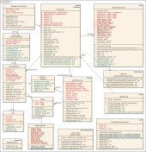

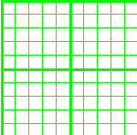
Application
Apply TaTAMi
Browsing
Inventory
Page
Render
Browse Servlet
Inventory Accessor
Order State
User
Auth
Order Servlet
User Data
Purchasing
Notes:
Now, an analysis with TaTAMi could reveal many things about this scenario. We apply it, and it will start by tagging data read from the databases, and provided by the user. This is then tracked as it flows through the application. The analysis will show that data flows to the order state objects, and persists across requests. We have discovered application state.
Now the point should be made that we could have obtained similar data by heavily monitoring all I/O of the application, but such a technique is much less targeted, and thus risks gathering a bunch of other data to sort through, like the flow of data that we don’t care about, which isn’t likely to generate program state, and while also being a much computationally heavier process. Plus taint tracking tells you where state ultimately came from, which is very useful for a developer to reason about it.

Slide 11
Application
Browsing
Stateless
Page
Render
Browse Servlet
Page
Render
Browse Servlet
On-premise (private)
Page
Render
Browse Servlet
Inventory
Inventory Accessor
Order State
Careful!
Purchasing
Purchasing
User
Auth
Memory Constraints?
Unreliable Instance State?
User Data
Order Servlet
Order Servlet
Order Servlet
Order Servlet
Order Servlet
Order Servlet
Notes:
So having done that analysis on the application’s state, we can point out some useful things. First, the browsing system is stateless, and thus we know that replication will be very easy. If we want, we can even have the same system at multiple data centers with the benefits that such provides. If a data center fails, we can switch to another location with less to worry about.
The purchasing system, however, we now know keep persistent state. There may be some issues with moving into the cloud. For example, the state means increasing memory requirements for increasing numbers of users, and there may be constraints on how much memory you can use with a particular cloud provider. Or maybe keeping state in memory is a bad idea altogether. Google App Engine, for example, does not let applications run continuously, and will shut down your application periodically, wiping out in-memory state.

Slide 12
Application
Apply TaTAMi
Browsing
Inventory
Page
Render
Browse Servlet
Inventory Accessor
Order State
User
Auth
Personal State
Order Servlet
User Data
Purchasing
Notes:
Okay, so knowing about the state is useful, but we could go further. From the dataflow graph we might be able to determine that some state is personal state, meaning that it isn’t used to share data between multiple users. Rather it is only used to keep the state of individual users.

Slide 13
Application
Browsing
Stateless
Page
Render
Browse Servlet
Page
Render
Browse Servlet
On-premise (private)
Page
Render
Browse Servlet
Inventory
Inventory Accessor
Order State
Order State
Purchasing
Purchasing
User
Auth
User Data
Order Servlet
Order Servlet
Order Servlet
Order Servlet
Order Servlet
Order Servlet
Notes:
In this case we might be able to relocate the state to the user – the tracking will help evaluate how feasible this is, and identify what else might need to be relocated to the user (such as code which processes the state data). This could be indicated to the developer, who’s responsibility it would be to modify the application to do this.
Such a modification could make the purchasing system stateless on the serverside, and we can potentially have the same freedoms as with the browsing system.

Slide 14
Application
Apply TaTAMi
Browsing
Inventory
Predictable Input
Page
Render
Browse Servlet
Processing
Inventory Accessor
Order State
User
Auth
Order Servlet
User Data
Purchasing
Notes:
Let’s look at something else. Taint tracking can reveal, along the path of data destined for the user, points where that data is modified, such as in the page rendering component, where inventory items are combined with HTML to produce webpages for the user to view. This may be an expensive process, and taint tracking can show us that the inputs to this process are only from rarely changing, predictable sources.

Slide 15
Application
Browsing
Browsing
Stateless
Stateless
$
Page
Render
Browse Servlet
Cache
Browse Servlet
Page
Render
Browse Servlet
Page
Render
Browse Servlet
Browse Servlet
On-premise (private)
Browse Servlet
Inventory
Inventory Accessor
Order State
Purchasing
User
Auth
User Data
Order Servlet
Order Servlet
Order Servlet
Notes:
In this case we might when suggest precomputing some page renders and caching them in order to speed load times and lower the burden on our cloud, and thus the cost of using it. Knowing that this is possible would have an effect on partitioning algorithms which consider the cost of deploying application components in the cloud.

Slide 16
Application
Apply TaTAMi
Unpredictable Input
Browsing
Inventory
Predictable Input
Page
Render
Browse Servlet
Processing
Inventory Accessor
Order State
User
Auth
Order Servlet
User Data
Purchasing
Notes:
Similarly, TaTAMi might instead reveal that the input to the page generator includes unpredictable user input, in which case

Slide 17
Application
Browsing
Browsing
Stateless
Stateless
$
Page
Render
Browse Servlet
Page
Render
Browse Servlet
Browse Servlet
Page
Render
Browse Servlet
Browse Servlet
On-premise (private)
Browse Servlet
Inventory
Inventory Accessor
Order State
Purchasing
User
Auth
User Data
Order Servlet
Order Servlet
Order Servlet
Notes:
It might not be such a good idea to do something like this, at least not without some deeper consideration.

Slide 18
Application
Apply TaTAMi
Relocatable
Inventory
A
Browsing
B
Page
Render
Browse Servlet
Stationary
Mostly A
Inventory Accessor
Order State
Dependent
User
Auth
Order Servlet
User Data
Purchasing
Notes:
This next example involves collecting data will could be useful for when trying to restructure the application to achieve a better partitioning.
Say we have some data which cannot be relocated, but some other data we have more freedom with in its placement. We might consider moving the data to the cloud. Tracking shows us two main things here. First, these two data sources might be very dependent on each other, being involved in calculations together before reaching the user. Second, the data which flows between two components may be mostly derived from the relocatable source.

Slide 19
Items
Application
Browsing
Stateless
Inventory Accessor
Page
Render
Browse Servlet
Page
Render
Browse Servlet
On-premise (private)
Page
Render
Browse Servlet
On-premise (private)
Items
Stock
Stock
Inventory Accessor
Inventory Accessor
Order State
Purchasing
User
Auth
User
Auth
User Data
User Data
Order Servlet
Order Servlet
Order Servlet
Notes:
Say in our partitioned example, the Items data is relocatable, the Stock data is not. Most of the data communicated between on premise and the cloud is Items data. We might then want to move the access to the Items data into the cloud to save on communication costs. However, the problem is a dependence between the Stock and Item data. Say the accessor needs to read from both to find items which aren’t in stock and remove them from the list of items to show to the user. If you just run the Inventory Accessor in the cloud, need may end up suddenly communicating a lot of Stock data instead, and not get much benefit in the end. Being aware of this is useful.

Slide 20
Application
Apply TaTAMi
Relocatable
Inventory
A
Browsing
B
Page
Render
Browse Servlet
Stationary
Mostly A
Inventory Accessor
Order State
Indepedent
User
Auth
Order Servlet
User Data
Purchasing
Notes:
In a different case, say the dependence doesn’t exist, the two data sources are accessed in well separated paths

Slide 21
Items
Application
Browsing
Stateless
Modified Accessor
Inventory Accessor
Page
Render
Browse Servlet
Page
Render
Browse Servlet
On-premise (private)
Page
Render
Browse Servlet
Special
Items
Modified Accessor
Inventory Accessor
Order State
Purchasing
User
Auth
User Data
Order Servlet
Order Servlet
Order Servlet
Notes:
For example, instead of inventory stock, maybe it’s a table of special items which are read much like the regular items to be presented to the user. In this case we might suggest using modified accessors on premise and in the cloud, one which is responsible for separately accessing the items table, and another which is responsible for accessing special items. The freedom to move the items table into the cloud ultimately gives us a better partitioning, and it was the taint tracking data which indicated that this was possible.

Slide 22
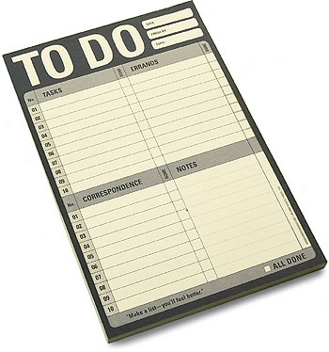
Future
Making sense of the data
-Visualization
-Analysis code
Evaluation
-Toy applications
-Optimizing a real application
Integration
-Nima’s tool
Notes:
Now, with that, what do I have left to do?
-First, all of those examples I just gave are conceptual things that I hope to do. Now that I’m collecting taint tracking data, I need to make sense of it to realize these analysis. First, I am currently working on visualizing some of the data I’m collecting, mainly for the purpose of having a cool demo but also to help make sense of it when working on the analysis code.
Once I have some analyses happening, it’s on to evaluating and demonstrating if my system works. Much of that can be done by creating toy applications much like what I just presented, and showing how my tool is able to say useful things about them. A more interesting undertaking, however, would be to take a real application that I did not write, run my tool on it, and then attempt to act on some of the data it produces.
Finally, I could consider integrating my system with an actual application partitioner, as Nima is working on one, to show how the data that it collects is useful to such tools.

Slide 23

Notes:
Any questions?

